Slide 1
Road to GEO Post-2025 – Setting the Scene

Slide 2
Road to a GEO post-2025 by Humbulani Mudau Member of the Post-2025 Working Group

Slide 3
The Post-2025 Working Group
Establishment by the 57th Executive Committee meeting in March 2022
Mandate: develop proposal for a “GEO Post-2025 Strategic Mission”. Consult with GEO community, ExCom, Plenary,..
Final draft for ministerial endorsement at the 2023 Summit
Composition: 28 persons

Slide 4
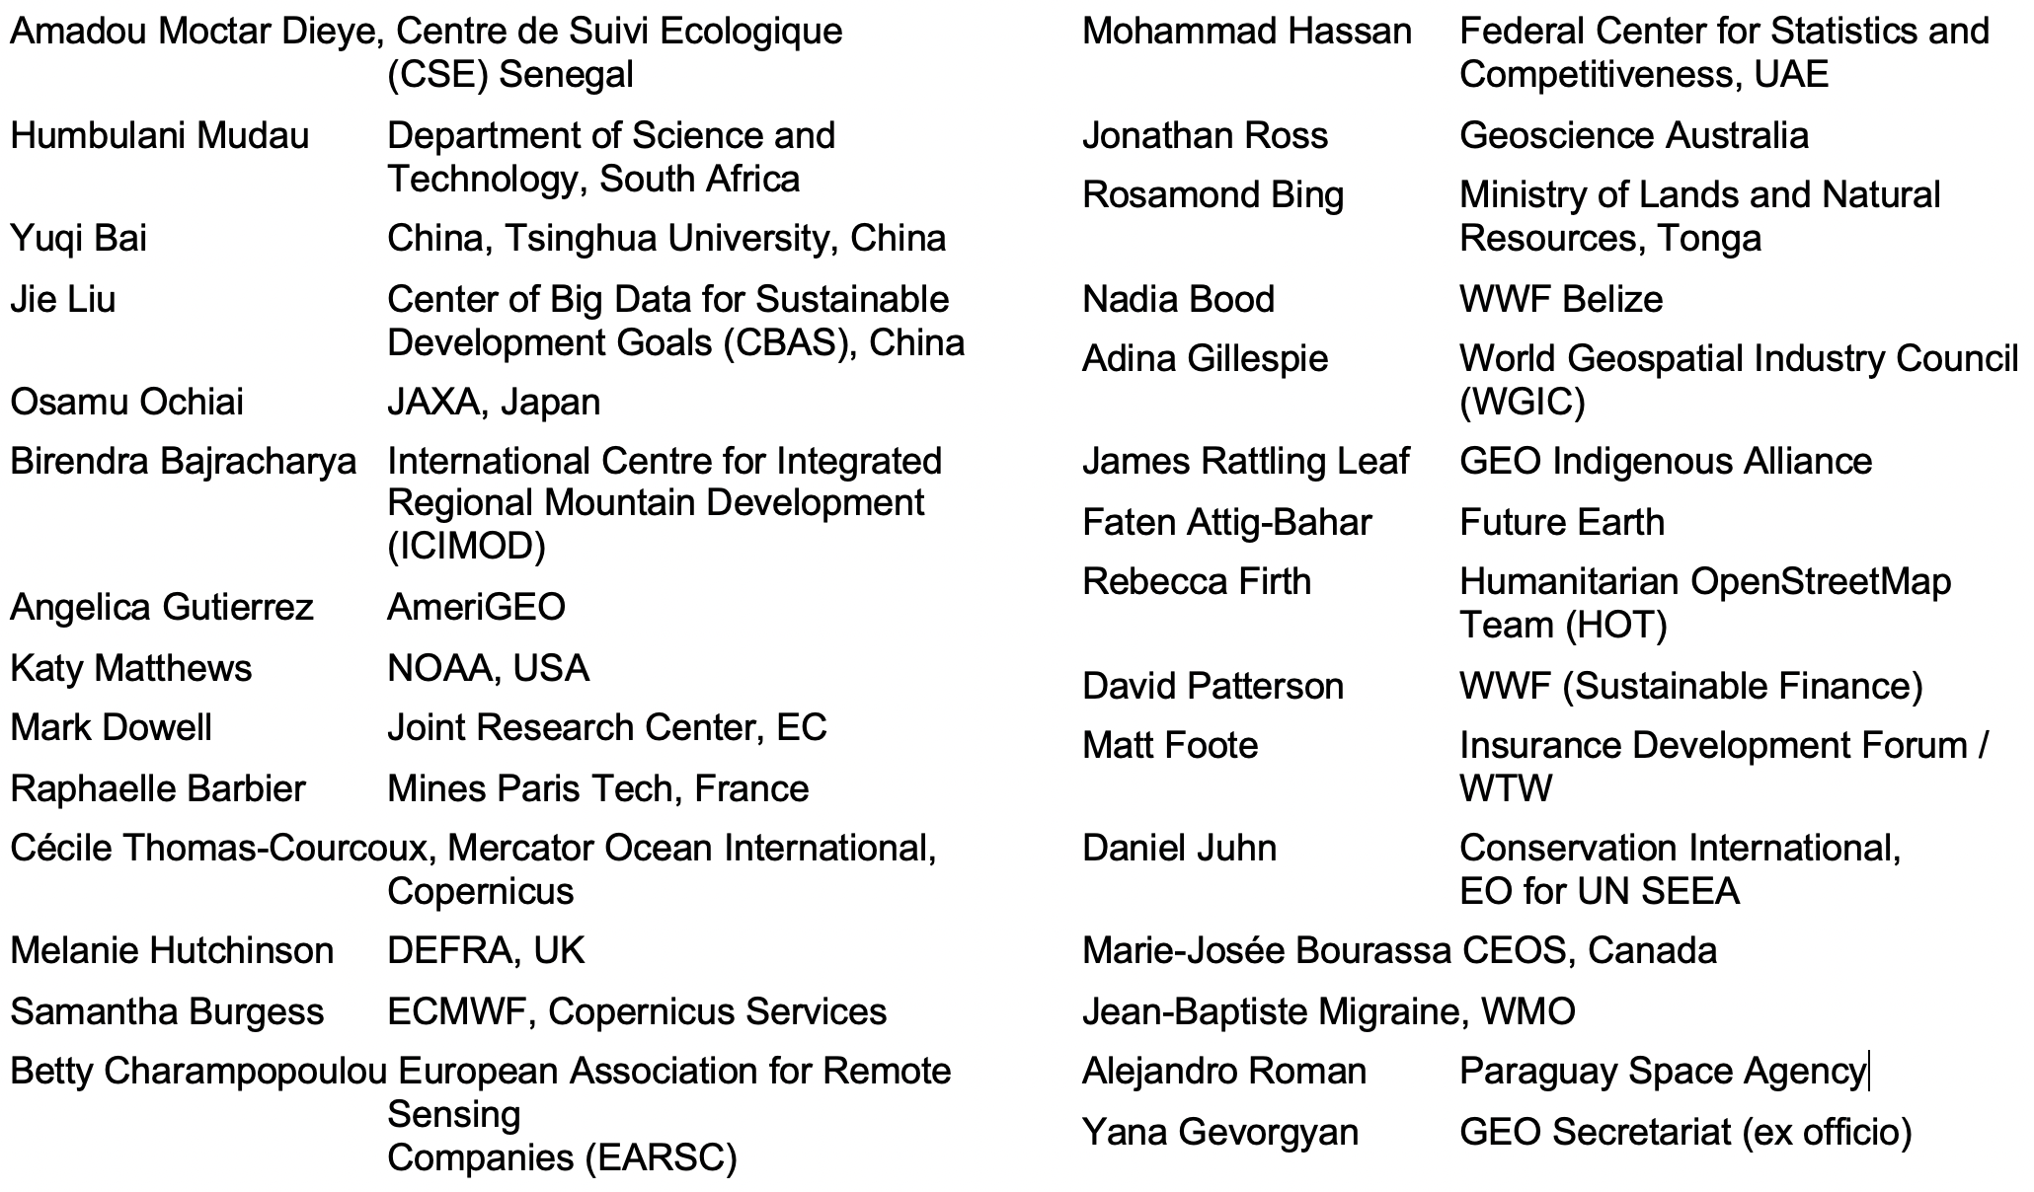
Composition of the Post-2025 Working Group

Slide 5
Process leading to the Ministerial Conference
1st meeting (virtual)
2nd meeting (virtual) 11-12.7.
3rd meeting (virtual) 30-31.8.
4th meeting (on site) 20-21.9.
GEO Week 31.10.-4.11.
2022
Community engagement
Further meetings of the post-2025 working group
60th Executive Committee meeting (March 2023)
July 2023
Ministerial Conference (4-8 December 2023), Cape Town, South Africa
2023
(indicative)
…
Community engagement
Ministerial working group

Slide 6
Situation Analysis
Policy trends
Increased demand, use and application of Earth observation
Increasing importance of private sector (value added)
Observation systems to Earth information services
ESG, spatial finance, renewable energy, integrated policy agendas (SDGs)
Widening digital gap between developing and developed countries
Technological trends
Service application and modelling
Miniaturization
Earth observation systems enhanced with innovations (citizen sensors, ocean observations,..) community
Artifical intelligence, machine learning, big data,…

Slide 7
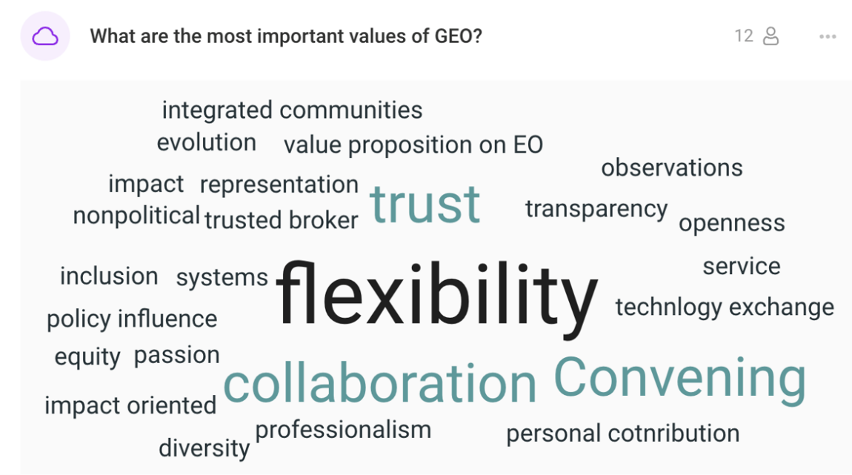
2nd meeting 11-12 July 2022
Strategic foresight
Focus areas
Situation analysis Strategic positioning
Scope and format of the strategy, value proposition
Community engagement

Slide 8
3rd meeting 30-31 August 2021
What is our passion? What can we do best?
Accelerating for impact: uplifting consensus and injecting ambition: PPP, diversifying support and identifying and addressing societal challenges
Elements of the strategy: What do we want to achieve? What do we do and how?
Representation & Governance, Resources / Fundraising, Measuring success and impact

Slide 9
4th meeting: intermediary conclusions
Building on the 17 years of successes, ideas behind vision still valid
Making GEO fit for purpose
Accompanying factors to propel GEO towards the vision (GEO as “Catalyst”)
Respoding to user needs: e.g. facililtating access to high-resolution data
World is different than 17 years ago, therefore harnessing opportunities

Slide 10
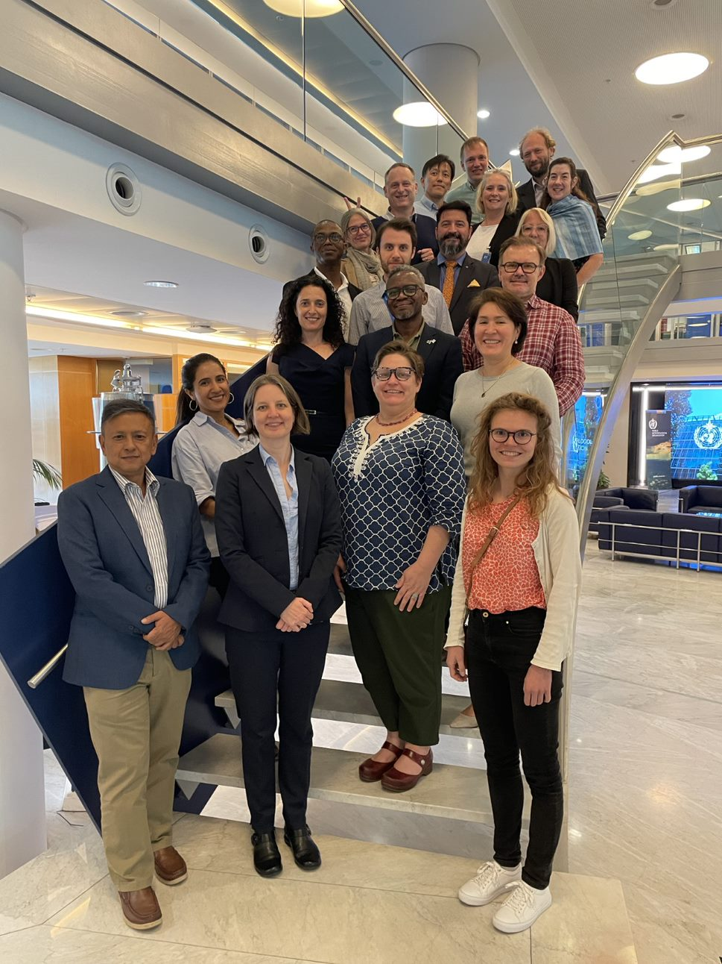
Community engagement
Past activities: AmeriGEO Week 2022, CEOS, GEO House Event, 15th AOGEO Symposium
Current outreach activities:
AfriGEO Symposium
GEO-18 Plenary
…

